Slide 2
The increases or decreases in house prices are managed by many macroeconomic factors. However, lately, with the drastic climate change, there has been a concern about these changes reflected in home insurance policies and house prices.
The average surface temperature in the UK has increased by 1.2°C, and all of the decarbonization routes suggested by the Intergovernmental Panel on Climate Change call for further warming. The goal is to keep warming to 1.5°C, but the research indicates that we need to be ready for warming of up to 4°C.
There are two types of major risks posed by climate change – physical risk and transitional risk.
A lot of mortgage organizations developed an interest in the consequence of the drastic climate change as it could challenge the solvency of the companies. This has given rise to the demand of understanding the effect of flood events on house prices.
It has become very critical to understand if homebuyers understand physical risks, especially flood events, and whether these risks are considered before making an offer.

Slide 3
Beneficiary:
MIAC Analytics Ltd - This project was part of an internship at MIAC Analytics Ltd, specializing in property analytics in the UK. The company holds a large amount of transactional data as it follows repeat sales methodology for its analysis which is based on minimum data usage. With the rise in climate change, the company is interested to understand and estimate if there is any underlying effect of flood events on UK house prices and if the effect can be generalized as a flat discount on house prices. The company was keen on understanding the flood data and its correlation and causation on UK house prices.
Homeowners who commit financially to the long-term value of their home through a mortgage can, in theory, be fully aware of the value-diminishing possibility of current and future flooding.
Research Questions:
What was the discount applied on the UK house prices due to flood events?
Do buyers overlook the flood risk when choosing a property with river proximity?

Slide 4
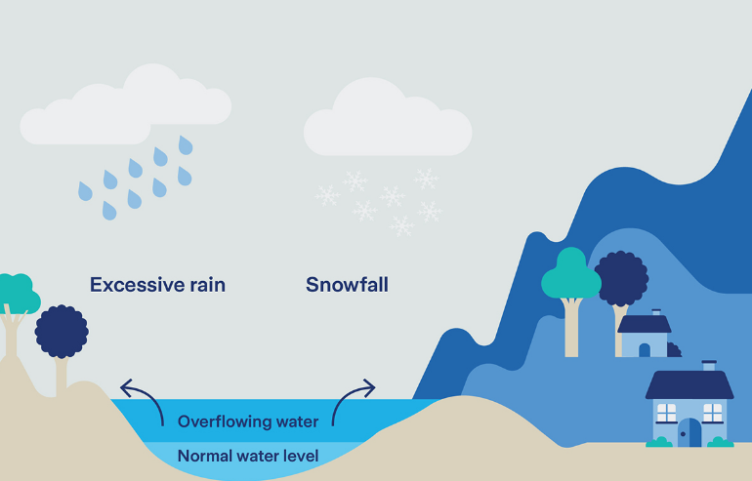
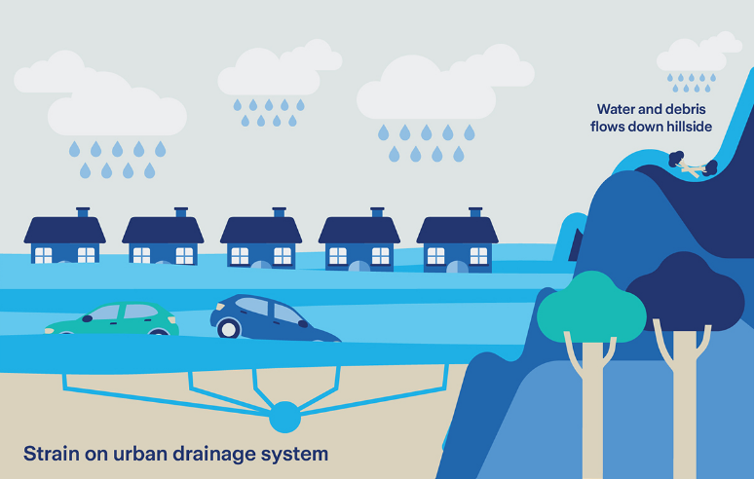
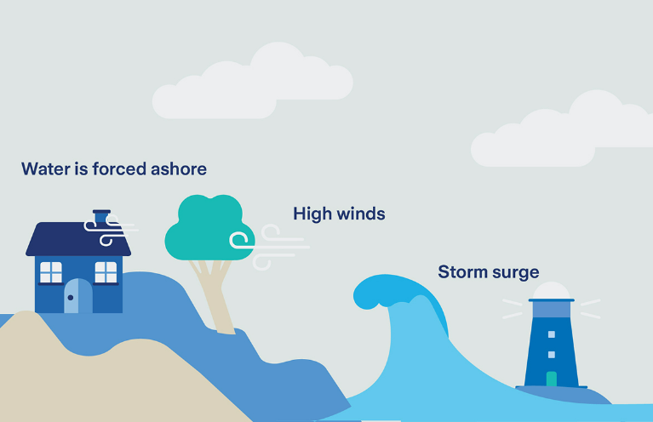
Flood and its terminology:
Fluvial floods, Pluvial floods, and Coastal flood
Return Period:
100 year return period:
500 year return period:
1000 year return period:

Slide 6
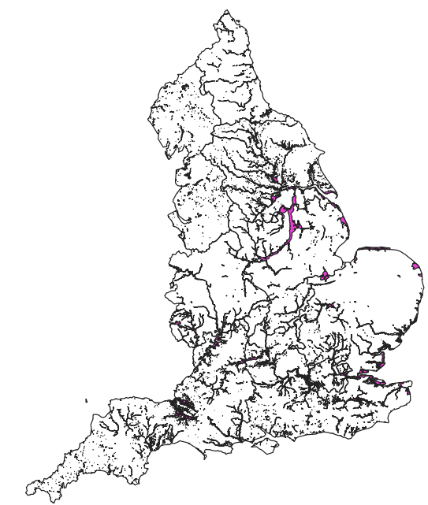
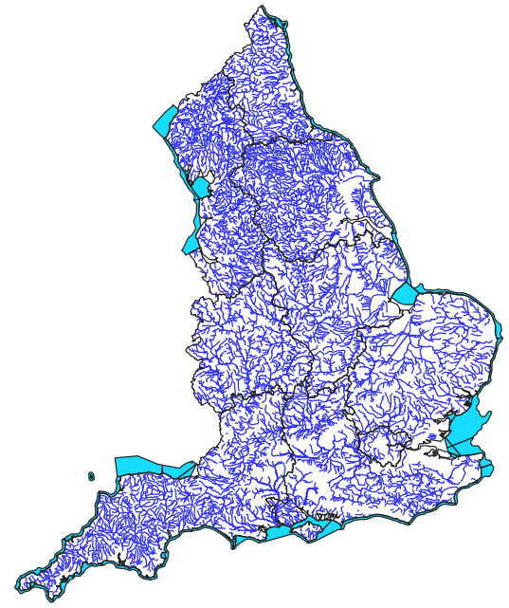
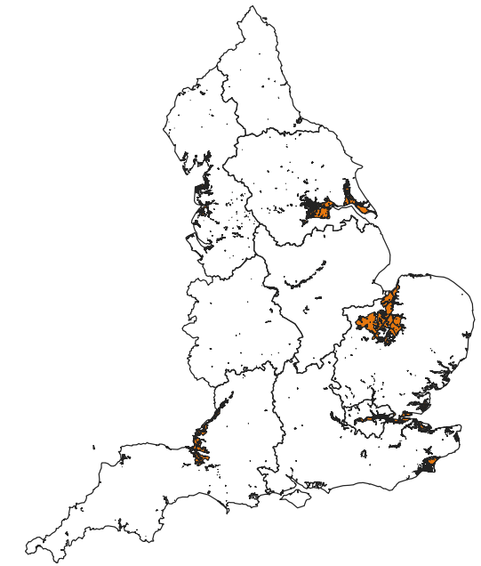

Slide 8
Treatment-Control group
The treatment variable:
1 – The transactions of the postcode were impacted by the 2013 winter flood
0 – The postcode was never impacted by any flood events and the flood risk category is ‘None’.

Slide 9
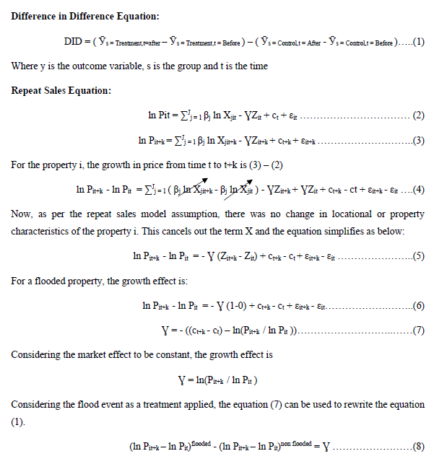
Outcome Variable:

Slide 10
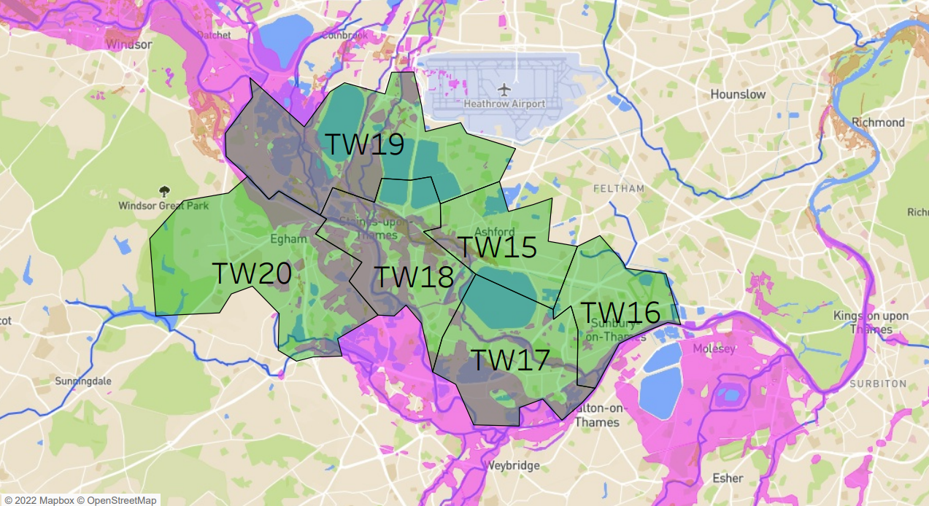
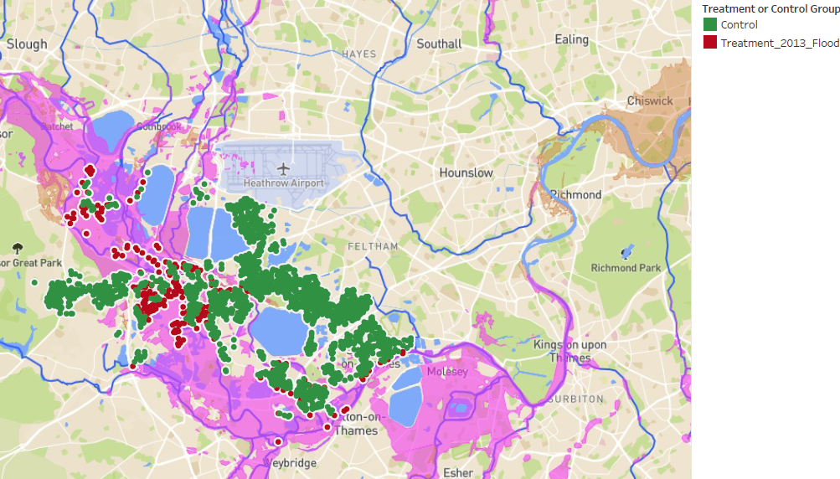
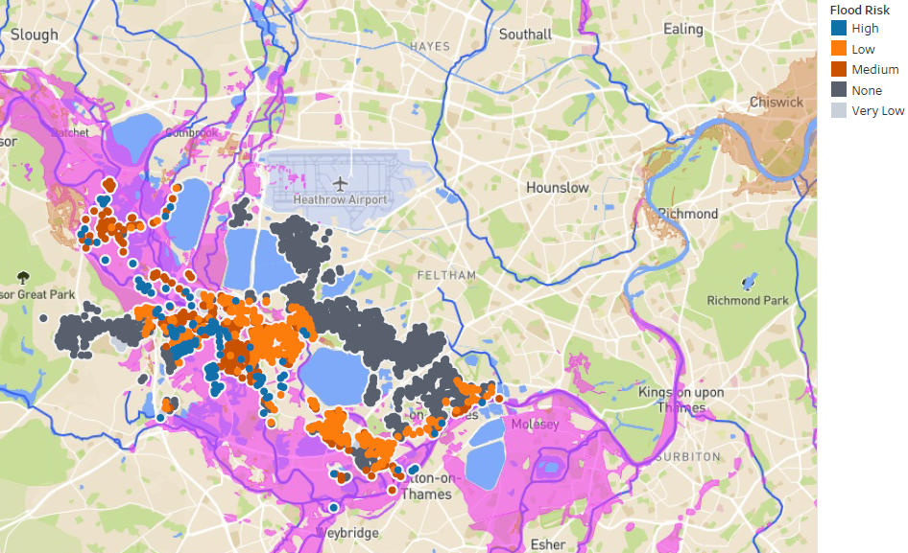

Slide 11
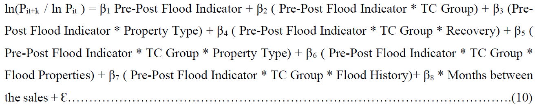
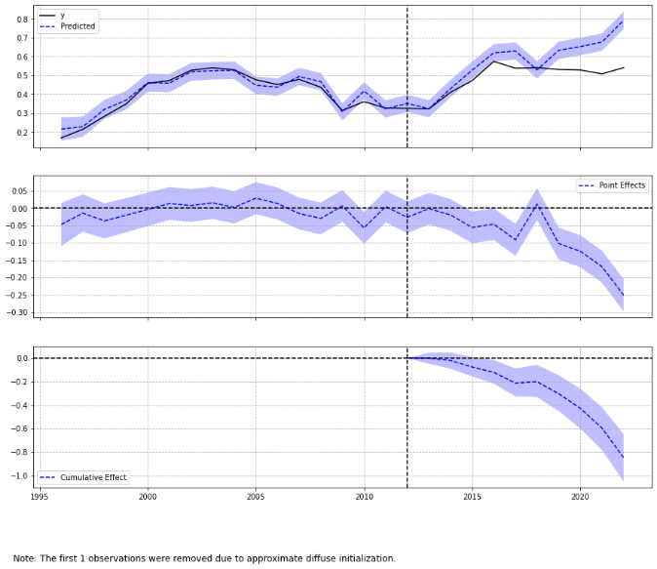
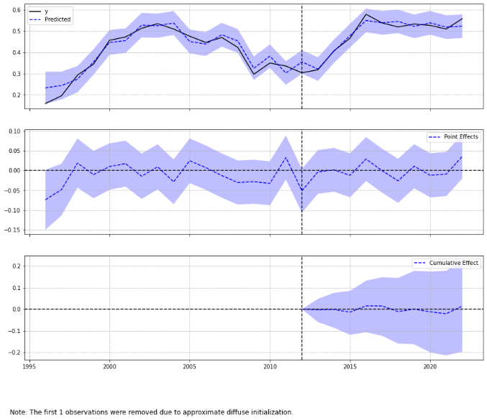
Methods and their challenges
DID:
Hybrid Model:
Causal Impact: Time series model developed by Google. An 8% discount and 95% interval of this prediction is [5.62,6.02].

Slide 12
META Learners:
ATE = E[Y(1) – Y(0)]
A meta-algorithm (or meta-learner) is a framework to estimate the Conditional Average Treatment Effect (CATE) using any machine learning estimators (called base learners) [16].
A meta-algorithm uses either a single base learner while having the treatment indicator as a feature (e.g. S-learner), or multiple base learners separately for each of the treatment and control groups (e.g. T-learner, X-learner and R-learner).

Slide 14
Unfortunately, it isn’t obvious at all how we achieve anything like a train-test paradigm in the case of causal inference. That’s because causal inference is interested in estimating an unobservable quantity.
Well, if we can’t see it, how are we supposed to know if our models are any good at estimating it?

Slide 15
we’ll use non random data to estimate our causal models and random data to evaluate it.
All curves will start and end at the same point. However, the better the model at ordering elasticity, the more the curve will diverge from the random line in the points between zero and one.
For example, in the image above, M2 is better than M1 because it diverges more before reaching the ATE at the end point. For those familiar with the ROC curve, you can think about Cumulative Gain as the ROC for causal models.
it’s calculated as the cumulative difference between the mean
outcomes of the treatment and control groups in each population

Slide 16
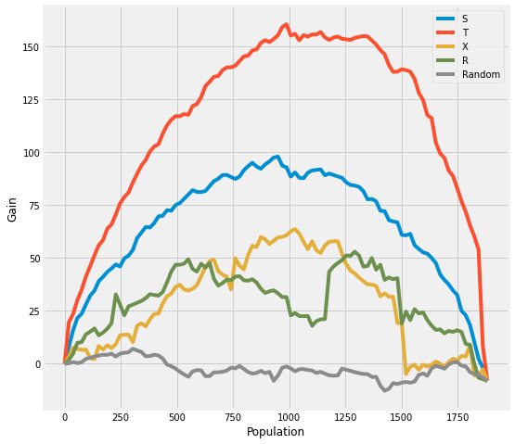

Slide 17
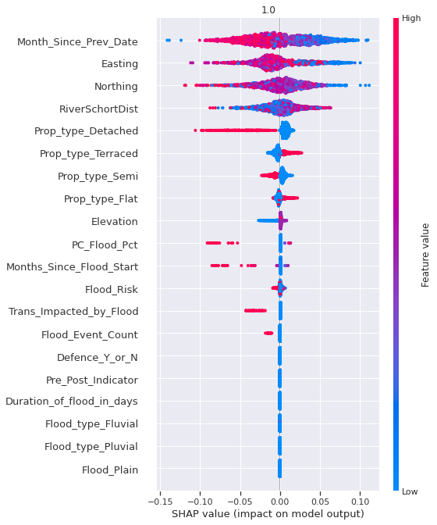

Slide 18
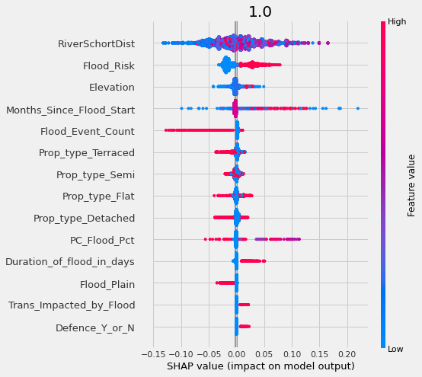
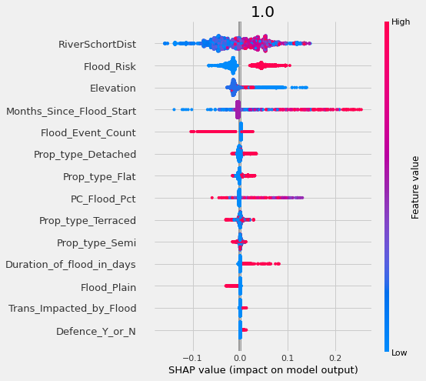
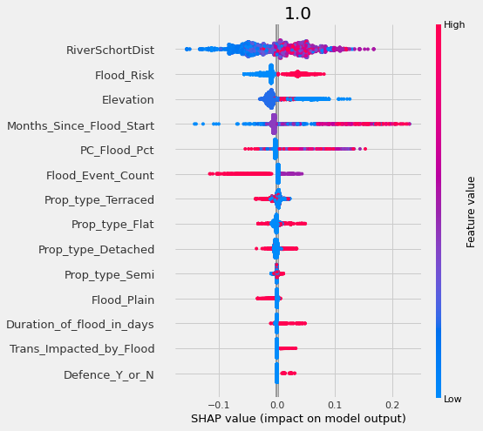

Slide 19
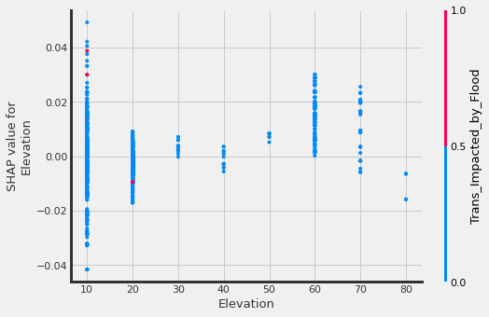
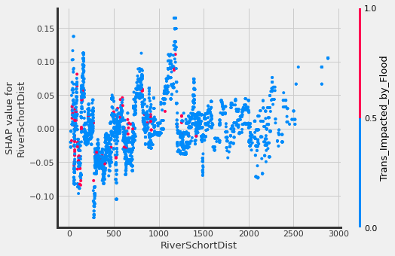
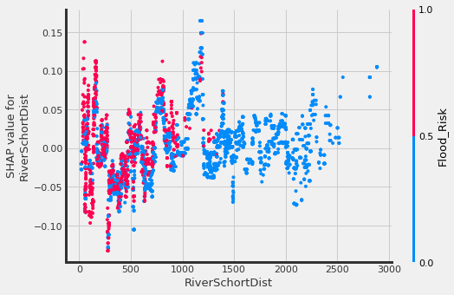
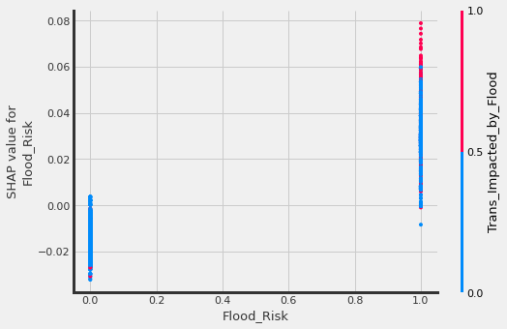
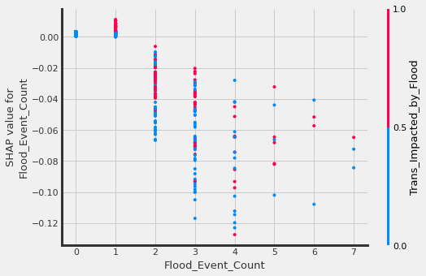
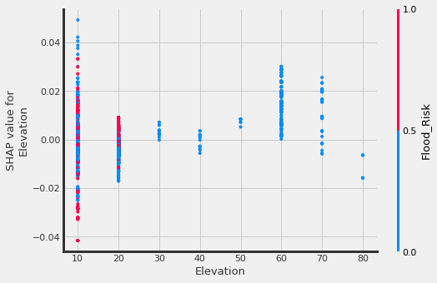

Slide 20
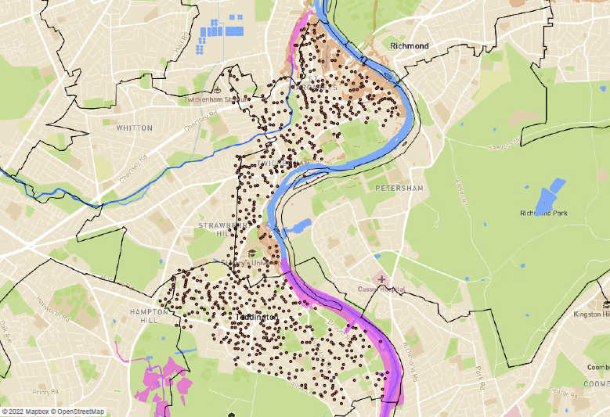
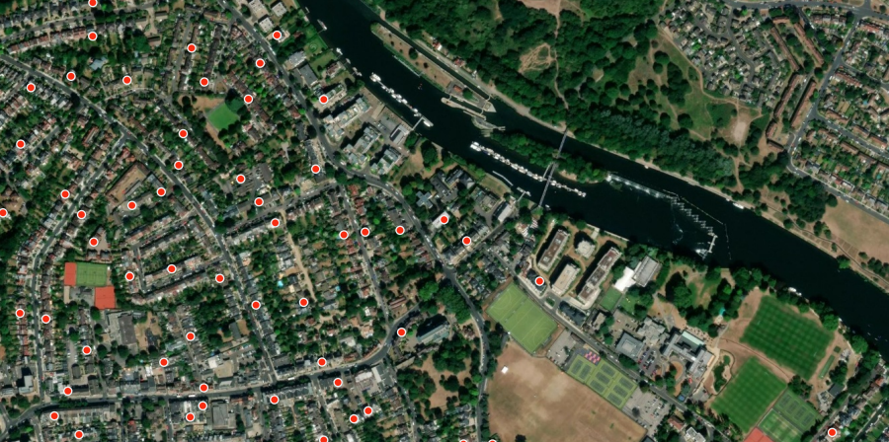
500 ft

